Slide 1
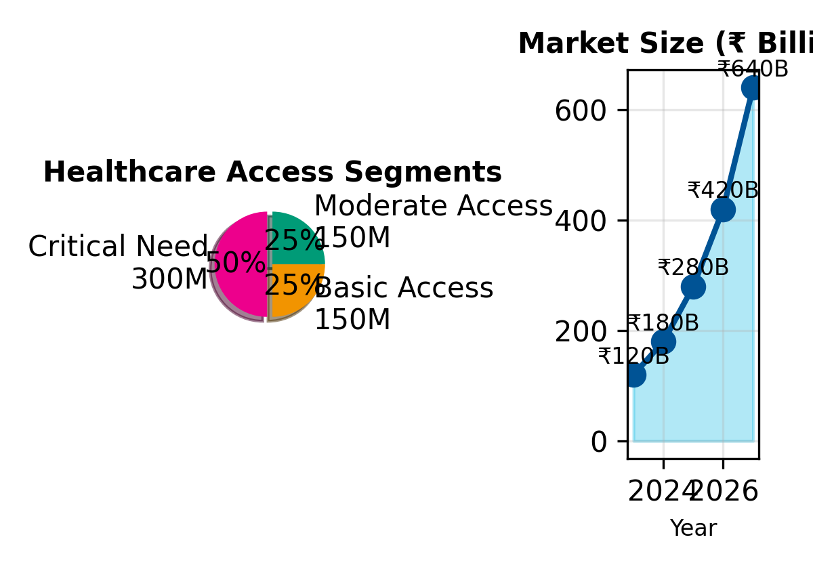
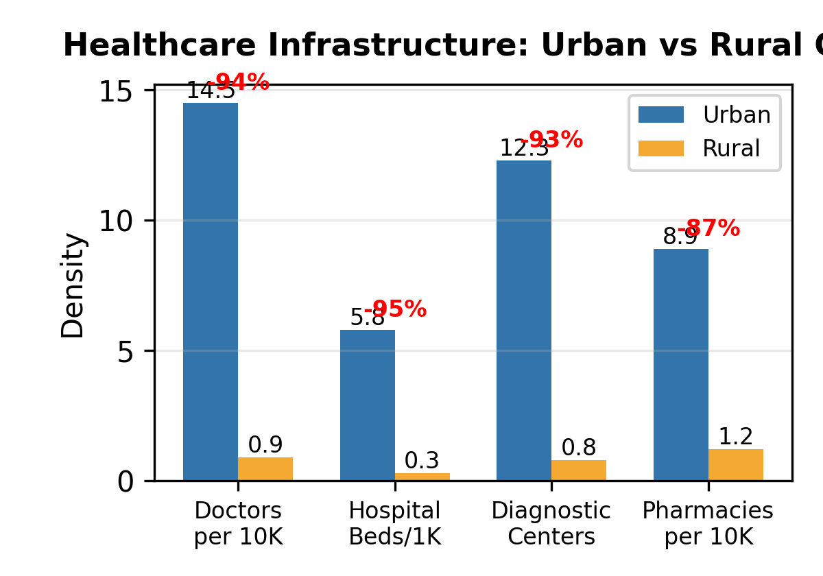
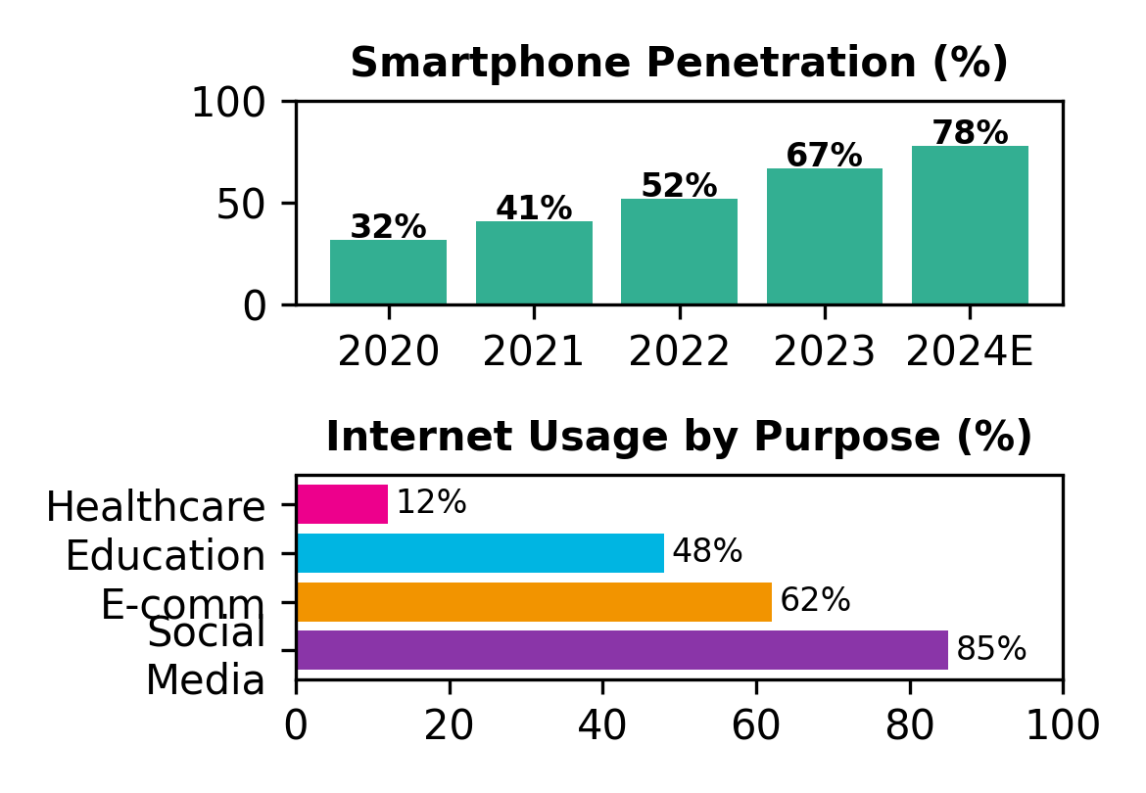
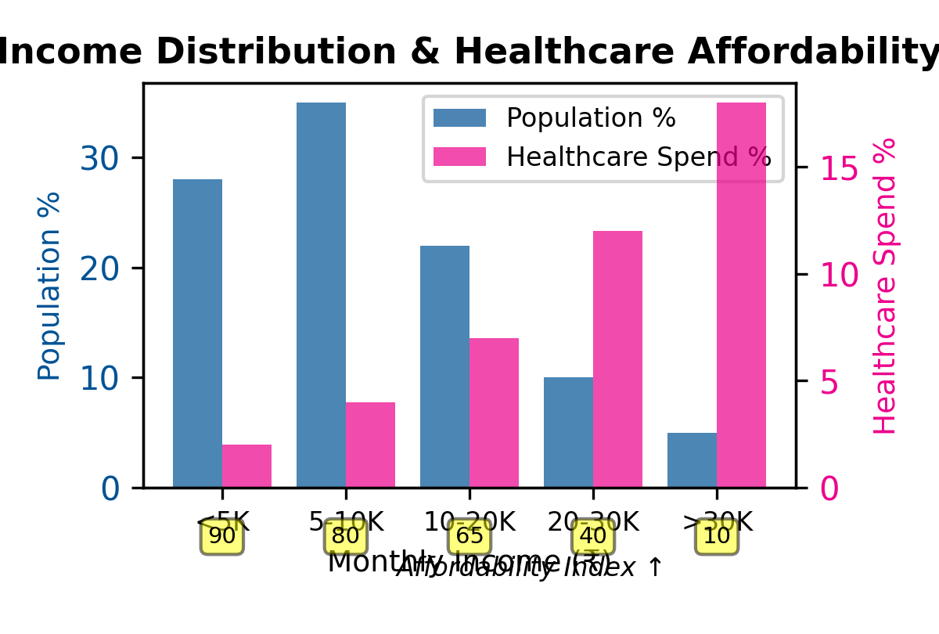
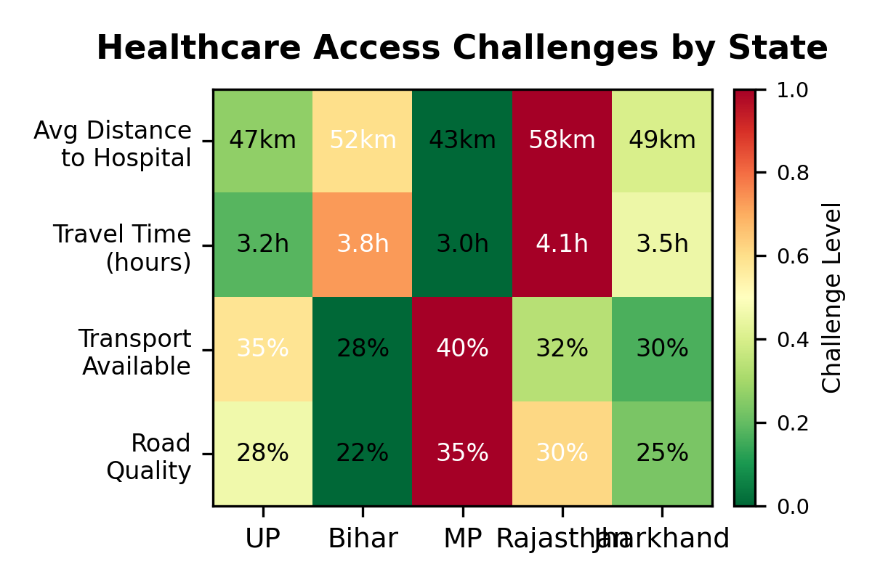
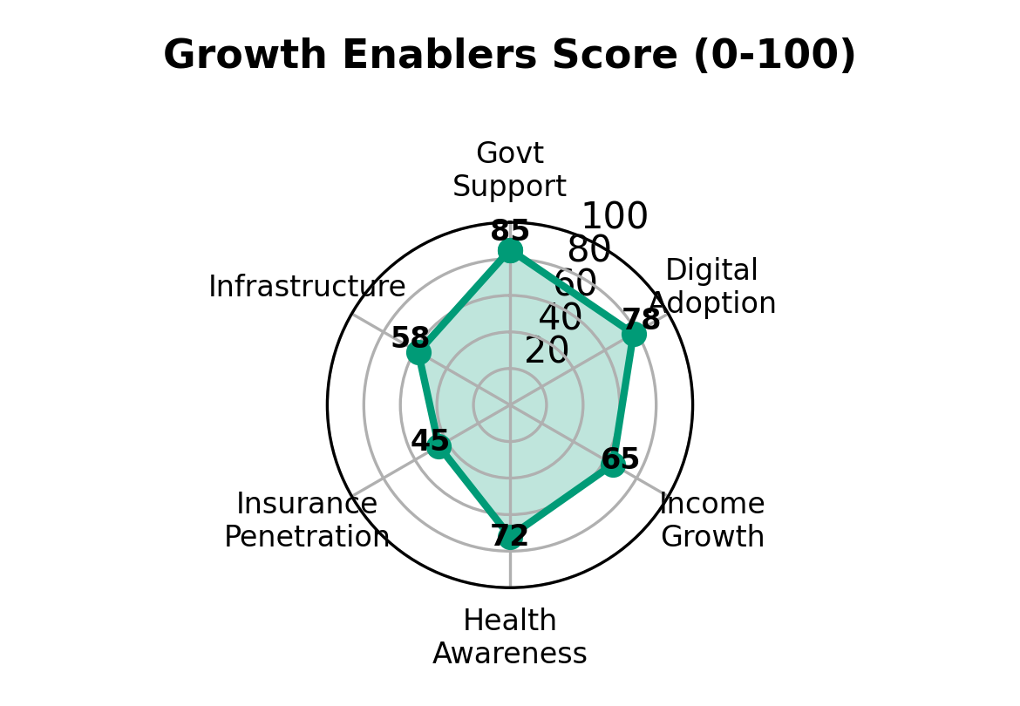
Tier 2/3 India: The ₹1.2 Trillion Healthcare Opportunity
600M underserved population with growing digital adoption
₹1.2T
Market Size by 2027
93%
Unmet Healthcare Demand
3.5hr
Avg Travel Time to Hospital
67%
Smartphone Penetration
600M lives | ₹1.2T opportunity | 93% unmet demand = India's largest untapped market

Slide 2
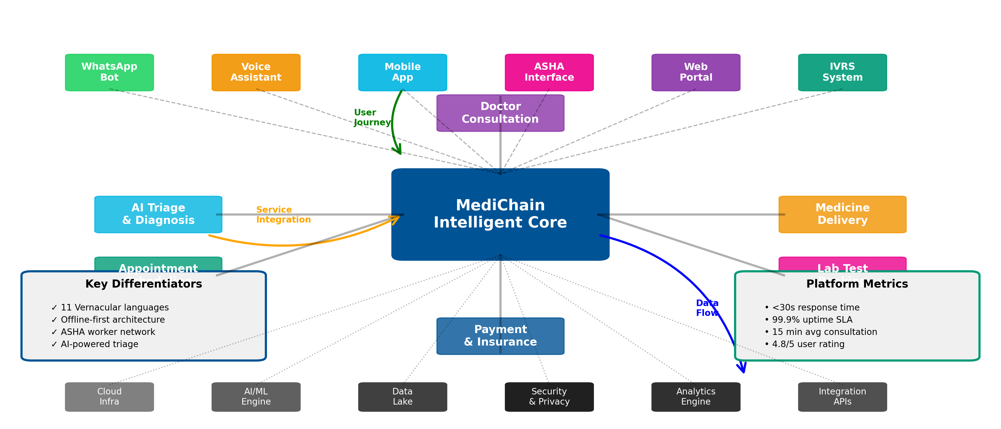
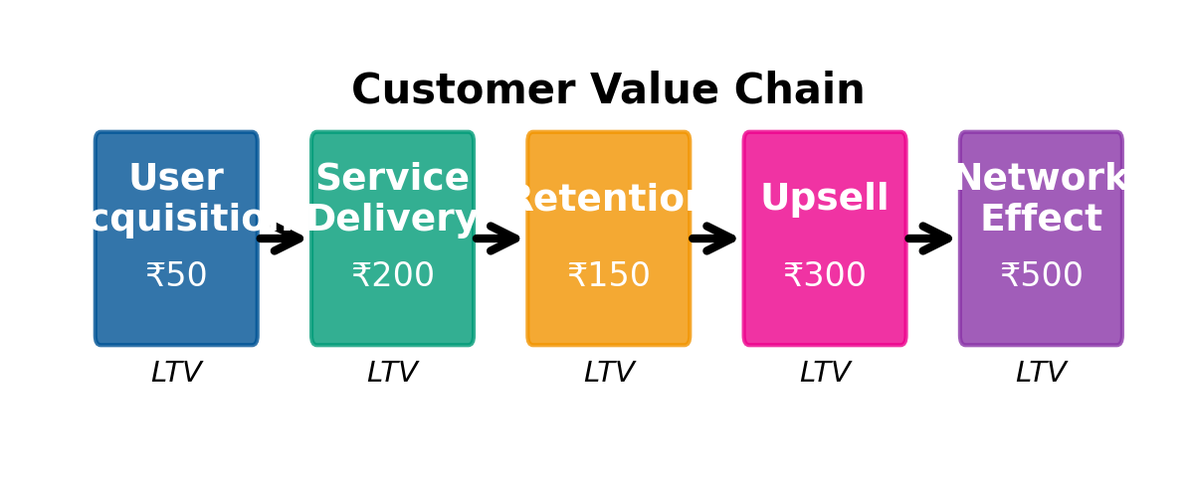
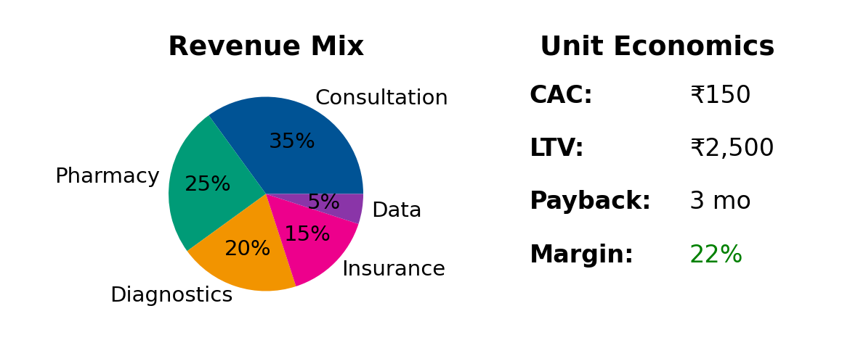
MediChain: End-to-End Digital Health Platform
AI-first approach | Vernacular-native | ASHA-integrated | Asset-light model
 | MediChain | Practo/1mg | PharmEasy
Rural Focus | ✓✓✓ | ✗ | ✓
Vernacular | 11 langs | English | 2 langs
ASHA Network | ✓ | ✗ | ✗
Affordability | ₹99/mo | ₹499/mo | ₹299/mo
Platform approach + Network effects + Multi-revenue streams = Sustainable competitive advantage

Slide 3
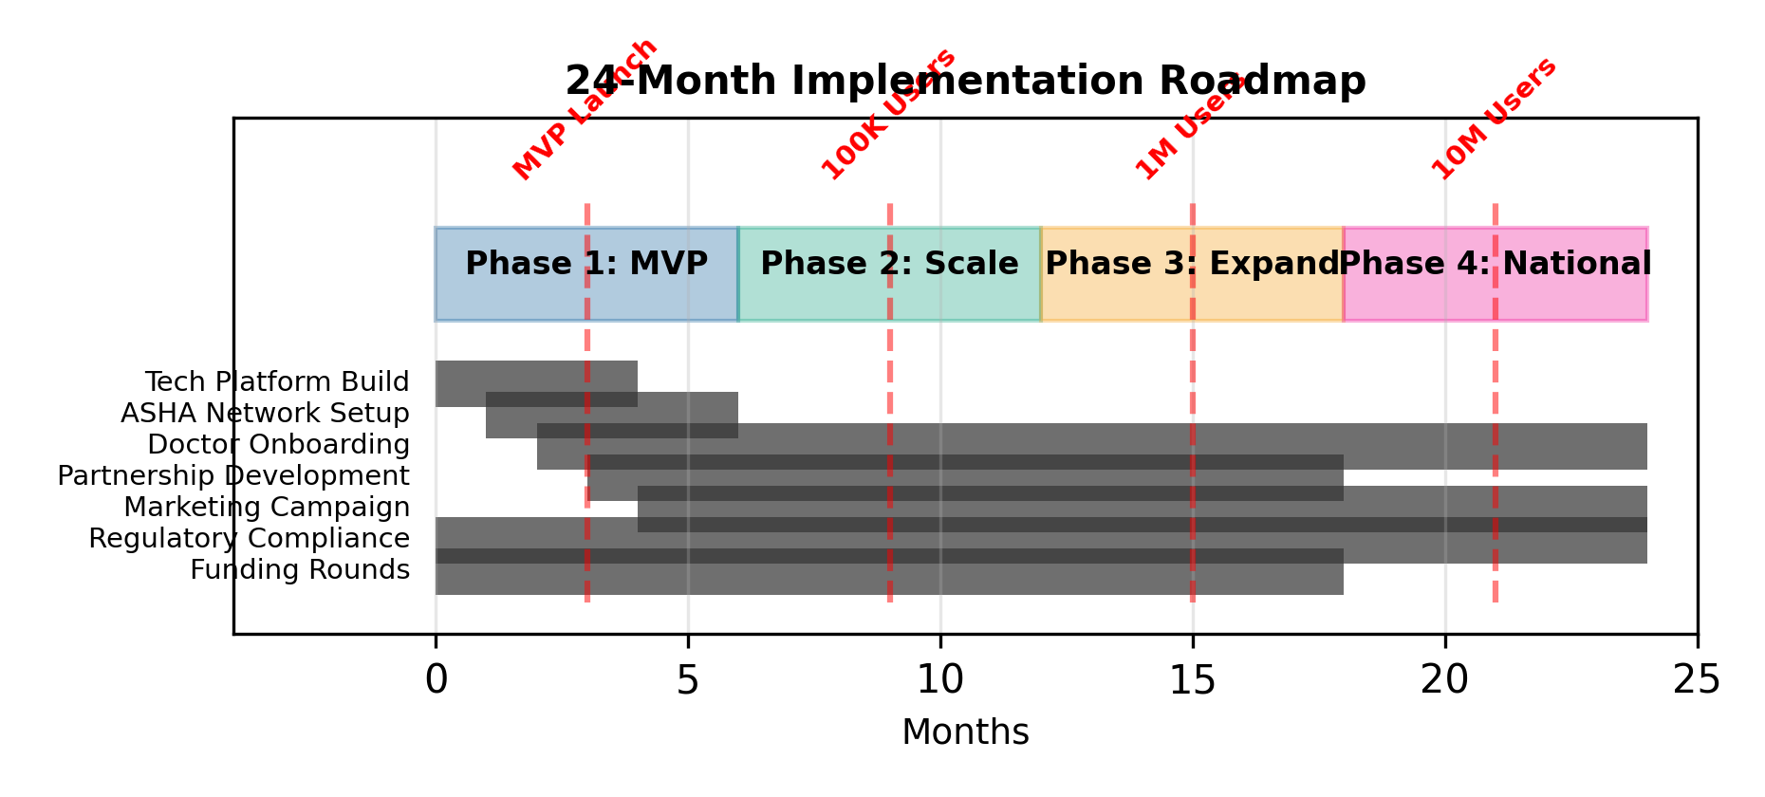
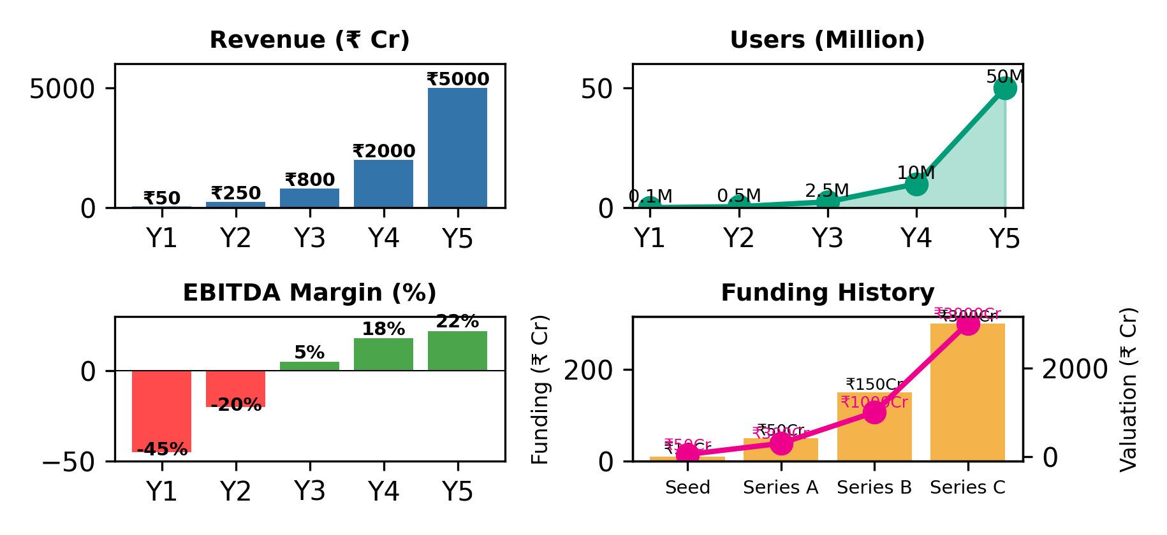
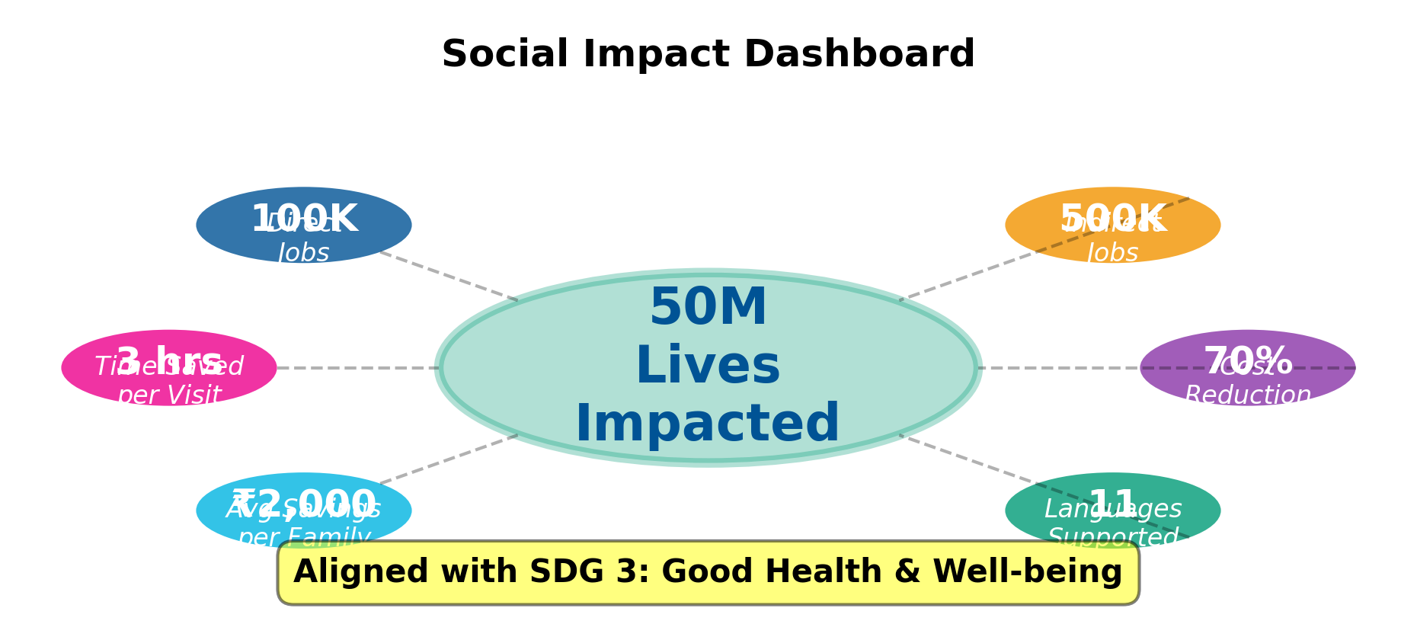
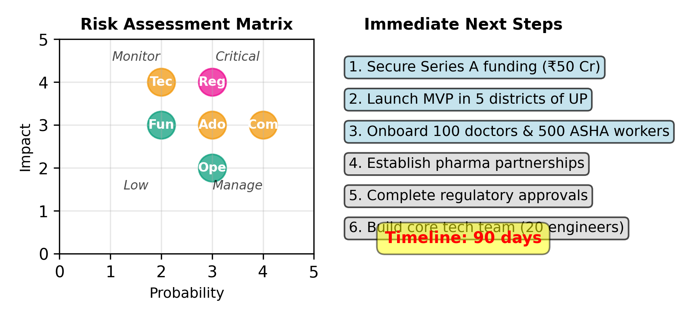
₹5,000 Cr Revenue | 50M Lives | Path to Profitability
24-month national rollout | Break-even by Month 30 | 22% EBITDA margin
₹5,000 Cr
Year 5 Revenue
50M
Lives Impacted
22%
EBITDA Margin
Month 30
Break-even
MediChain: Where social impact meets financial returns - transforming healthcare for Bharat

